Slide 1
INSURANCE ANALYTICS
Selvaji M Priyanka
Khyati Bhupendrakumar Soni
Anjali Singh
Dhanashri Shailesh Kanukale
Kavya S Churi
Mr.Md Talish raza

Slide 2

INTRODUCTION
Insurance analytics of a branch will help the corporate team and individual heads of the branch to analyze the
performance of branch as a whole and also individual contribution to the branch.
These analyses will help us to know where the branch is lacking and doing good job
in generating cross selling, renewals of existing business and how it is generating
new business.
How account executives of the branch performing? Who are exceptional in their
performance and who needs to improve in handling clients, meetings, etc. such
information will help branch to take necessary steps to provide good training to the
low performing executives.
This analyses will help branch to provide additional training or coaching to the sales
team on how to close deals and collect payments more quickly.
The insurance analyses provide some valuable insights into the performance of the corporate team. Use this
information to identify areas for improvement and develop strategies to help the teams to
achieve their goals.

Slide 3
Key performance indicators
1. No.of invoice by Account Executive
2. Yearly Meeting count
3. a) Cross sell – Target, Achieved, Invoice.
b) New – Target, Achieved, Invoice.
c) Renewal – Target, Achieved, Invoice.
4. Stage Funnel by Revenue.
5. No.of meeting by Account Executive.
6. Top Open Opportunity.

Slide 4
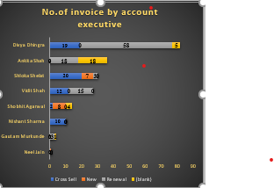
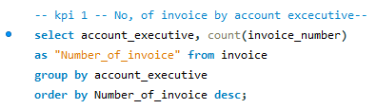
1. No.of invoice by Account Executive
These differences could be due to various factors such as client portfolios, industry segments, or the level
of experience among the executives. Understanding these factors could help optimize performance across
the board.
It would be beneficial to analyze the strategies used by the top
performers to see if these can be replicated by others. Additionally,
providing targeted training or support to those with lower invoice
counts could help improve overall team performance.
It should also explore if there are any external factors affecting the
performance of some executives, such as market conditions or client
engagement levels.

Slide 5
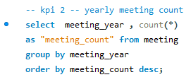
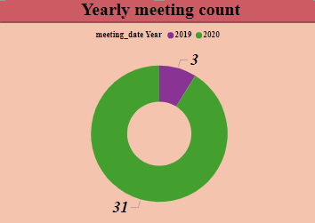
2. Yearly Meeting count
Through Kpi 2 branch can analyse yearly count of meetings held in particular branch for 2019 and
2020.
In 2019 only 3 meetings were held but that count increased to 31 in 2020. regular meetings can help
branch to discuss on matters that can improve performance of the branch.

Slide 6
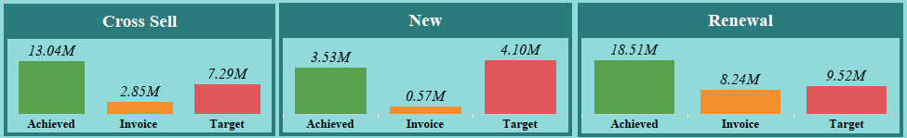
3. Cross sell, new, renewal – Target, Achieved, Invoice.
Cross sell - when we look at the cross sell of products to the existing customers it is
clear that branch have Achieved more than the Target amount. But, invoice didn’t meet
the set Target.
New - when it comes to new business of the branch it is clear that both Achieved and
invoice amount is not meeting set Target.
Renewal - when it comes to renewal of existing business of the branch we can see that set
Target have been Achieved but invoice is not meeting the Target.

Slide 7
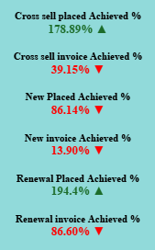
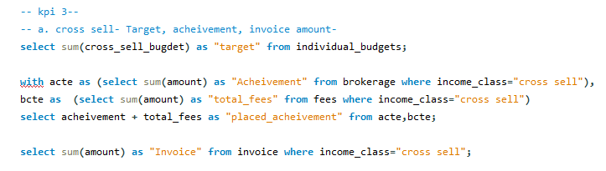
Placed Achievement % - It is clear that we have exceeded placed achievement percentage of the
branch in cross sell and renewal but need to improve in new business achievement.
Invoice Achievement % - when we look at invoice achievement percentage, all three cross sell, new,
renewal have not Achieved % as expected by the branch. A lot of work need to be done to reach the
invoice achievement %.

Slide 8
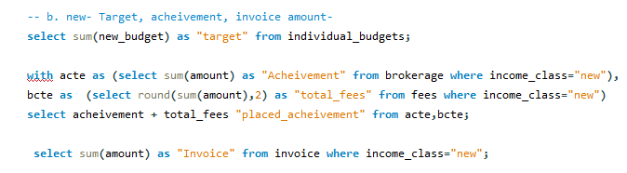
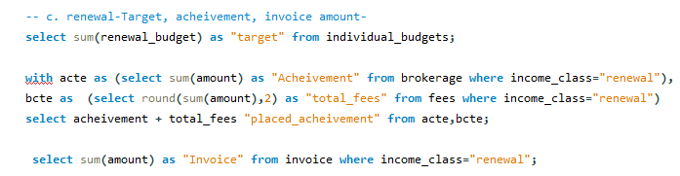

Slide 9
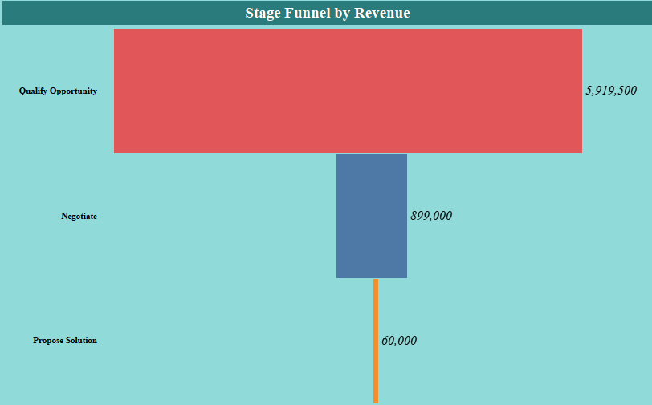
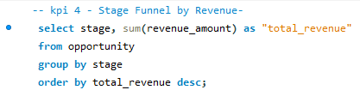
4. Stage Funnel by Revenue.
Stage wise performance in terms of revenue amount – we can
analyze which stage have more revenue through this kpi.
Funnel chart helps us to understand clearly that Qualify
opportunity stage has more revenue with 59,19,500, Negotiate
stage has 8,99,000 and Propose solution stage has least
i.e., 60,000.

Slide 10
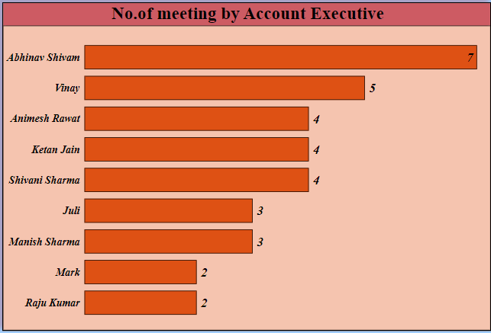
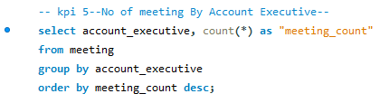
5. No.of meeting by Account Executive.
Through this kpi we can analyze Account executives
performance based on the number of meetings with clients.
Top performing account executives in terms of no.of
meeting with client are Abhinav, vinay, Animesh, ketan,
shivani and rest follows.

Slide 11

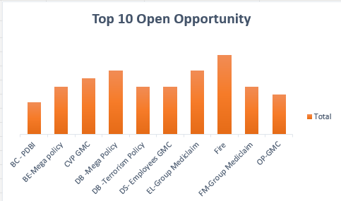
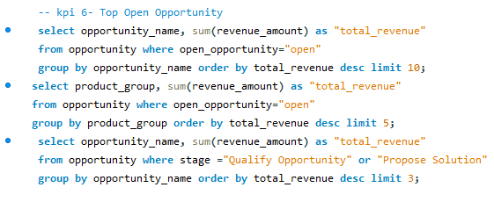
6. Top Open Opportunity
Stage wise opportunities based on revenue amount – we have 49 total opportunities and only 44 out of it are
total open opportunities based on revenue amount.
Top 10 open opportunities based on opportunity name and
revenue amount are Fire, DB-mega policy, EL group Mediclaim,
CVP GMC, BE-mega policy, etc.

Slide 12
DASHboards
Excel
Tableau
Power Bi

Slide 13
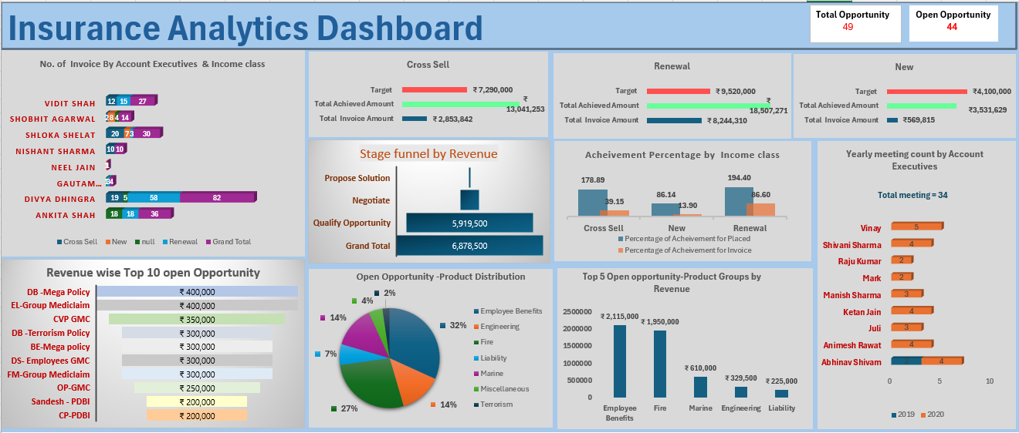

Slide 14
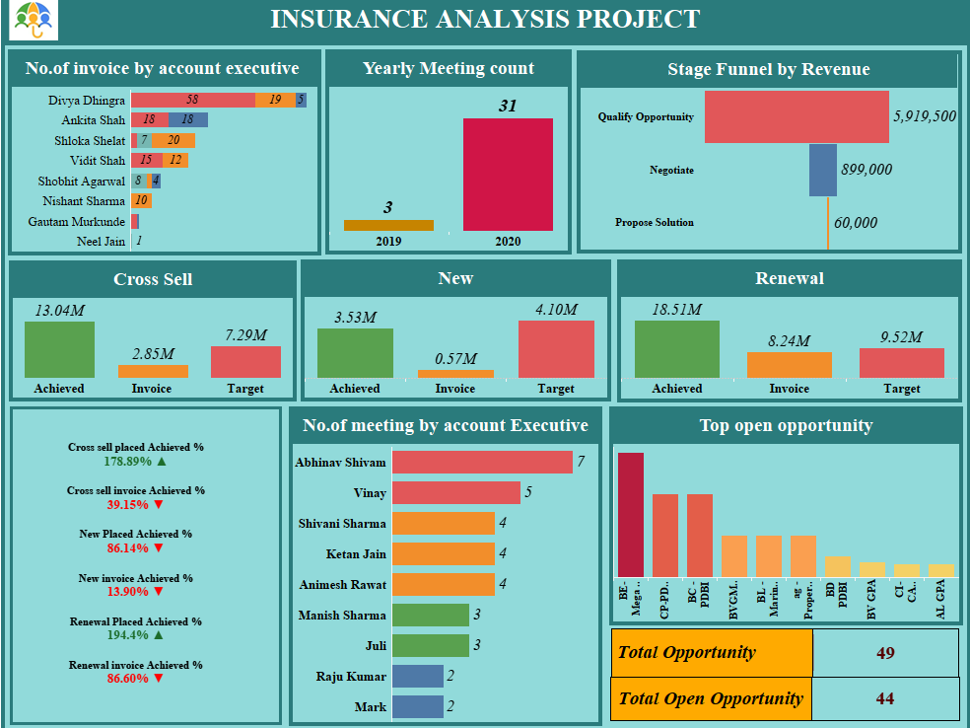

Slide 15
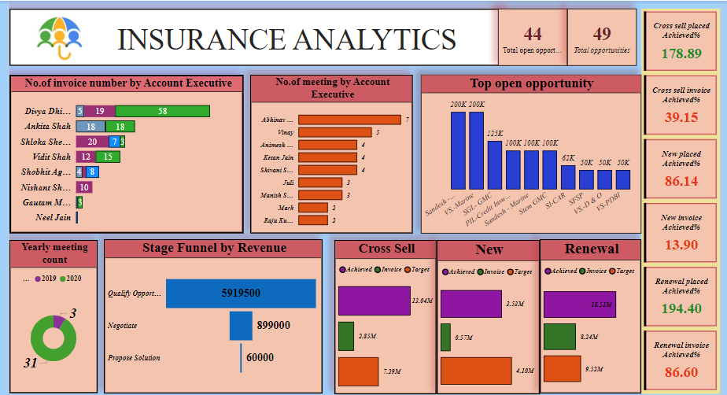

Slide 16
Thank you

